Slide 1
INDIA AIR POLLUTION DATASET
Preprocessing, Data Validation & EDA Preparation
Data types
Outlier analysis
Domain categories
Feature engineering
Dataset after cleaning: 432,396 rows × 13 original columns
Team 3
Rushikesh Shirwalkar
Ajay Seepana

Slide 2
1. Dataset & Cleaning Status
Starting point and current state after preprocessing
Rows after cleaning
Original columns
Duplicate records removed
Invalid-date rows removed
432,396
13
674
4
Duplicates and invalid-date rows removed
Before feature engineering
Verified with duplicated() check
Dates such as 31/06/2014 could not be validated
Key cleaning decisions
Categorical missing values were filled using logical, group-based methods or “Unknown”.
SPM and PM2.5 missingness was retained because it reflects unavailable historical measurements.
SO₂, NO₂ and RSPM were locally imputed where observations existed; remaining unavailable measurements were preserved.
Date was converted to datetime and the four invalid records were removed instead of inventing dates.

Slide 3
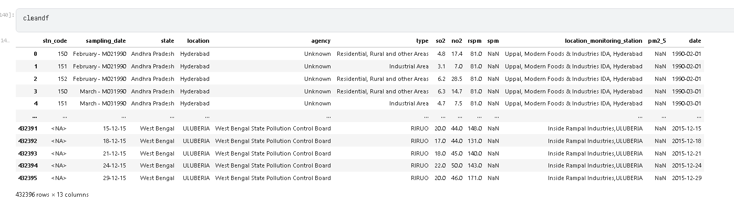
Dataset Overview

Slide 4
2. Data-Type Validation
Incorrect representations were corrected without changing meaning
Column / group | Before | After | Decision
stn_code | object | Int64 | Numeric station IDs; nullable integer preserves missing codes
date | object | datetime64[ns] | Required for time-based analysis
SO₂, NO₂, RSPM, SPM, PM2.5 | numeric-like | float64 | Confirmed as numeric measurement fields
state, location, agency, type, station name | object | object | Retained as categorical/text fields
Important interpretation
stn_code is stored as an integer for data consistency, but it remains an identifier—not a numerical analytical variable.
Validation: all observed pollutant values were non-negative (0 negative values across all five pollutant columns).

Slide 5
3. Outlier Analysis
IQR used to identify extreme observations; values were not blindly removed
Pollutant | Potential outliers | % of measured values | Upper IQR bound
SO₂ | 23,953 | 5.54% | 26.05
NO₂ | 19,364 | 4.48% | 59.00
RSPM | 14,548 | 3.41% | 267.17
SPM | 5,320 | 2.68% | 573.50
PM2.5 | 871 | 9.35% | 79.00
Decision
Retained
High readings can represent genuine environmental events. IQR flags statistical extremes, not necessarily data errors.
Validation checks
No negative concentrations were found.
No evidence justified automatic deletion or median replacement.
Extreme records were inspected by state, location, area type and date.

Slide 6
4. Extreme Observations – Investigation
Examples from the highest recorded values
Pollutant | Maximum | Observed context
SO₂ | 909.0 | Chennai, Tamil Nadu • Industrial Area • 2011
NO₂ | 876.0 | Jaipur, Rajasthan • Residential/Rural/Other • 2014
RSPM | 6307.03 | Lucknow, Uttar Pradesh • Residential/Rural/Other • 2010
SPM | 3380.0 | Alwar, Rajasthan • Industrial Area • 2001
PM2.5 | 504.0 | Bhubaneswar, Odisha • Residential/Rural/Other • 2014
Conclusion
Extreme measurements are traceable to specific stations, locations and dates. They were retained as potentially meaningful environmental observations.

Slide 7
5. Domain-Based Pollution Categorization
CPCB-referenced bands created for exploratory visualization
Variable | Low | Moderate | High | Very High
SO₂ | ≤ 40 | >40–80 | >80–120 | >120
NO₂ | ≤ 40 | >40–80 | >80–120 | >120
PM2.5 | ≤ 30 | >30–60 | >60–90 | >90
Reference point
SO₂: 80 µg/m³
NO₂: 80 µg/m³
PM2.5: 60 µg/m³
These are CPCB 24-hour NAAQS reference points. The surrounding bands are analytical visualization bands, not official AQI categories.
Resulting distributions
Variable | Observed category counts
SO₂ | Low 425,422 • Moderate 5,766 • High 778 • Very High 348 • Unknown 82
NO₂ | Low 371,767 • Moderate 53,293 • High 5,800 • Very High 1,470 • Unknown 66
PM2.5 | Low 4,154 • Moderate 3,656 • High 919 • Very High 585 • Unknown 423,082

Slide 8
6. Why We Did Not Encode Categories for ML
The project goal is EDA and visualization, not model training
Categorical encoding
Feature scaling
Interpretability
Not required
Not required
Preserved
Charts, groupby operations and Power BI can use text categories directly.
Scaling is generally unnecessary for descriptive charts and aggregation.
Keeping “Maharashtra” or “Industrial Area” is clearer than replacing them with codes.
This decision keeps the dataset readable while still following the mentor’s categorization approach for numerical pollution variables.
Categorical fields retained as-is
state • location • agency • type • location_monitoring_station

Slide 9
7. Feature Engineering for EDA
New fields make time-based and completeness analysis easier
New feature | Purpose
year | Annual pollution trends
month / month_name | Monthly and seasonal patterns
quarter | Quarterly comparisons
season | Winter / Summer / Monsoon / Post-Monsoon analysis
decade | Long-term period comparisons
pollutants_available | Measures how many of the 5 pollutant fields are observed per record
Season mapping
Winter: Dec–Feb • Summer: Mar–May • Monsoon: Jun–Sep • Post-Monsoon: Oct–Nov

Slide 10
8. Feature Engineering
Derived fields created from the cleaned datetime field and pollutant availability
Date-derived features
Season mapping
year
Annual trend analysis
Winter
Dec–Feb
month
Monthly comparisons
Summer
Mar–May
month_name
Readable chart labels
Monsoon
Jun–Sep
quarter
Quarterly grouping
Post-Monsoon
Oct–Nov
season
Seasonal comparison
Data-completeness indicator
decade
Long-term period grouping
pollutants_available = number of non-null measurements across SO₂, NO₂, RSPM, SPM and PM2.5.
2

Slide 11
11. Pollutant Measurement Completeness
The new availability feature quantifies how many pollutant measurements exist per record
3 pollutants
4 pollutants
2 pollutants
1 pollutant
229,914
201,875
541
66
53.17%
46.68%
0.13%
0.02%
of 432,396 records
of 432,396 records
of 432,396 records
of 432,396 records
Key finding
No observation contains all five pollutant measurements simultaneously. This confirms that pollutant availability differs across the historical monitoring records and should be respected during EDA.
3

Slide 12
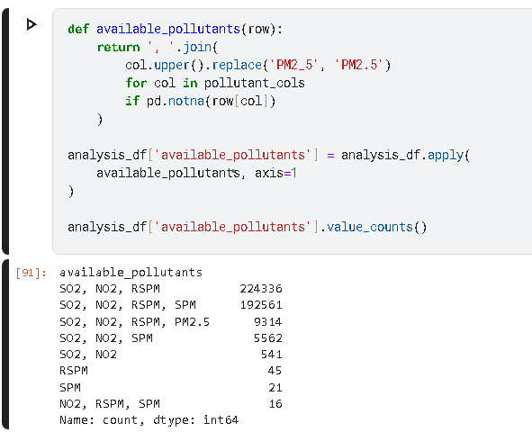

Slide 13
12. Feature Selection for EDA
Variables retained based on interpretability, analytical value and redundancy
Time
Geography
date • year • month • month_name • quarter • season • decade
state • location
Monitoring context
Pollution & completeness
agency • type
so2 • no2 • rspm • spm • pm2_5 • categories • pollutants_available
Reference-only / redundant fields: stn_code and location_monitoring_station are identifiers;
4

Slide 14
13. Correlation Analysis
Pairwise Pearson correlations among the five pollutant variables
SO₂
NO₂
RSPM
SPM
PM2.5
Key relationships
SO₂
1.000
0.349
0.164
0.162
0.034
RSPM ↔ SPM
0.757
NO₂
0.349
1.000
0.352
0.332
0.506
RSPM ↔ PM2.5
0.752
RSPM
0.164
0.352
1.000
0.757
0.752
SPM
0.162
0.332
0.757
1.000
NaN
NO₂ ↔ PM2.5
0.506
PM2.5
0.034
0.506
0.752
NaN
1.000
SO₂ shows weaker relationships with particulate pollutants. Correlation here is descriptive, not causal.
5

Slide 15
14. Important Data-Availability Finding
SPM and PM2.5 cannot be correlated from this dataset because they never co-occur
SPM observations
PM2.5 observations
Overlapping observations
198,160
9,314
0
measured values
measured values
therefore correlation = NaN
Interpretation
This is a data-availability limitation, not a pandas error. We should not impute one pollutant simply to manufacture overlapping observations or force a correlation value.
6

Slide 16
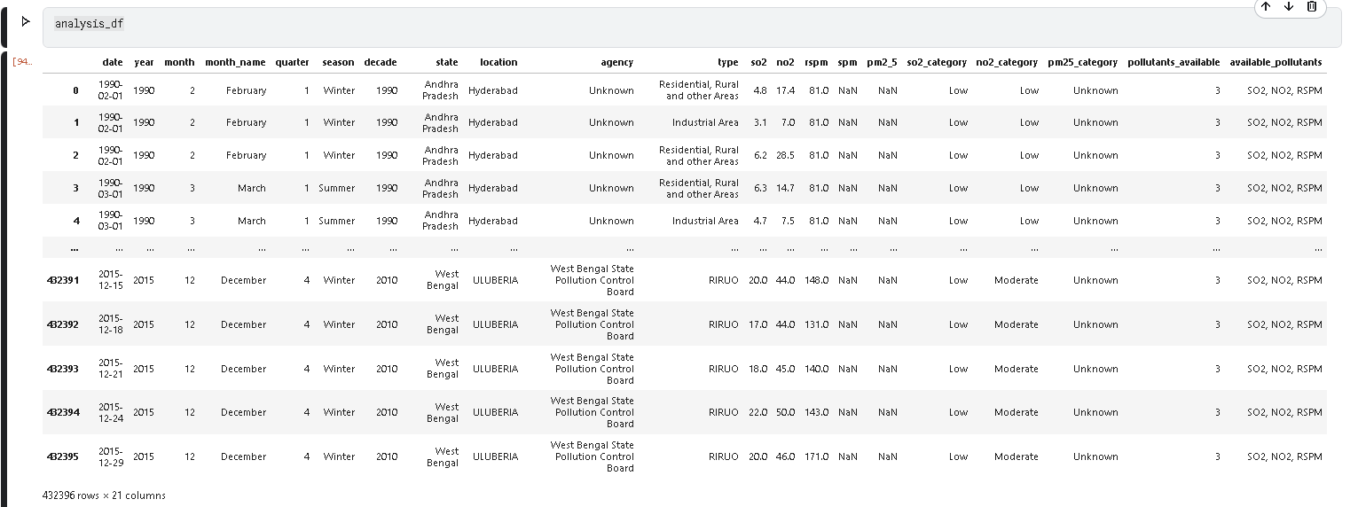
Dataset View After Milestone 2 processing

Slide 17
15. Analysis Dataset Ready
Current state after feature engineering and selection work
Feature engineering
Complete
Data completeness indicator
Complete
Feature selection for EDA
Complete
Categorical encoding
Not required for EDA
Feature selection
Not required for EDA
Visualization milestone
Next
7

Slide 18
16.Conclusion
Created meaningful time-based features: year, month, quarter, season, and decade.
Created pollutants_available to measure data completeness for each observation.
Developed domain-based pollution categories for SO₂, NO₂, and PM2.5 using CPCB-referenced thresholds.
Selected relevant variables for exploratory data analysis and visualization.
Identified strong relationships between RSPM–SPM and RSPM–PM2.5.
Identified an important data limitation: SPM and PM2.5 have no overlapping observations, so their direct correlation cannot be calculated.
Retained valid extreme pollution observations after outlier investigation rather than removing potentially genuine environmental events.
Dataset is now analysis-ready for the next milestone: Visualization and EDA.

